Slide 1
IMAGE PLAYER
TEAM 9
Arun Das
Avishek Kumar Sharma
Jugnu Gill
Ritvik Gupta

Slide 2
INTRODUCTION
SAVimage is a web-based application that lets one edit an image in real-time.
The application provides a variety of filters and features which the user can interact with to get the desired image.
The application also let’s you capture images in real time and then apply filters on it.

Slide 3
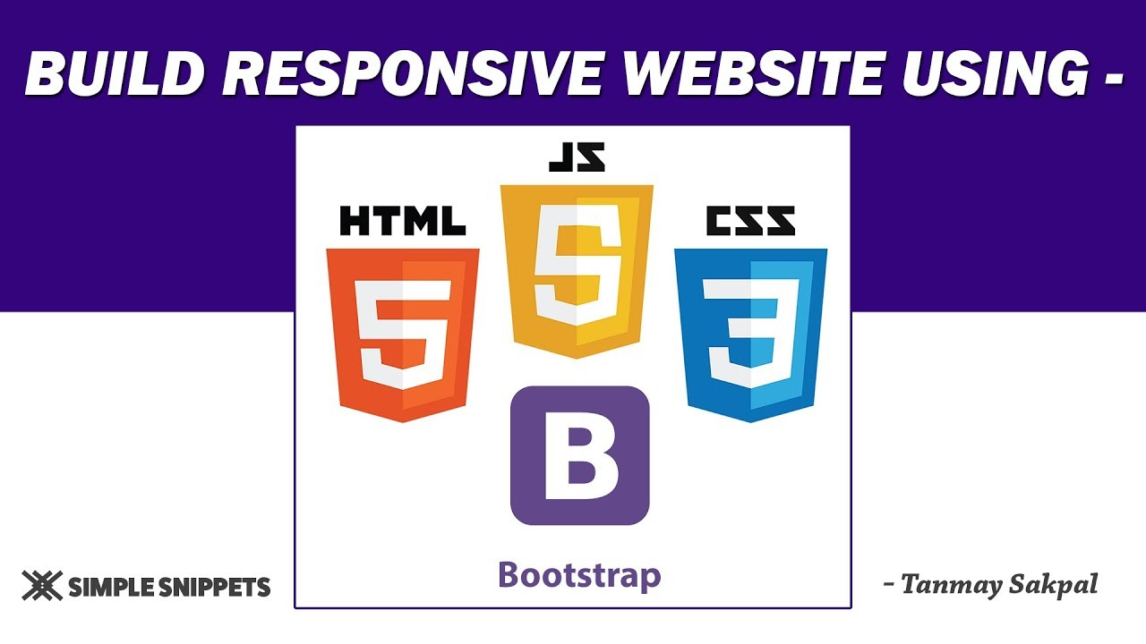

TECHNOLOGY STACK

Slide 4
FILTERS
Basic Filters
Image Transformation
Advanced Filters
AI Filters

Slide 5
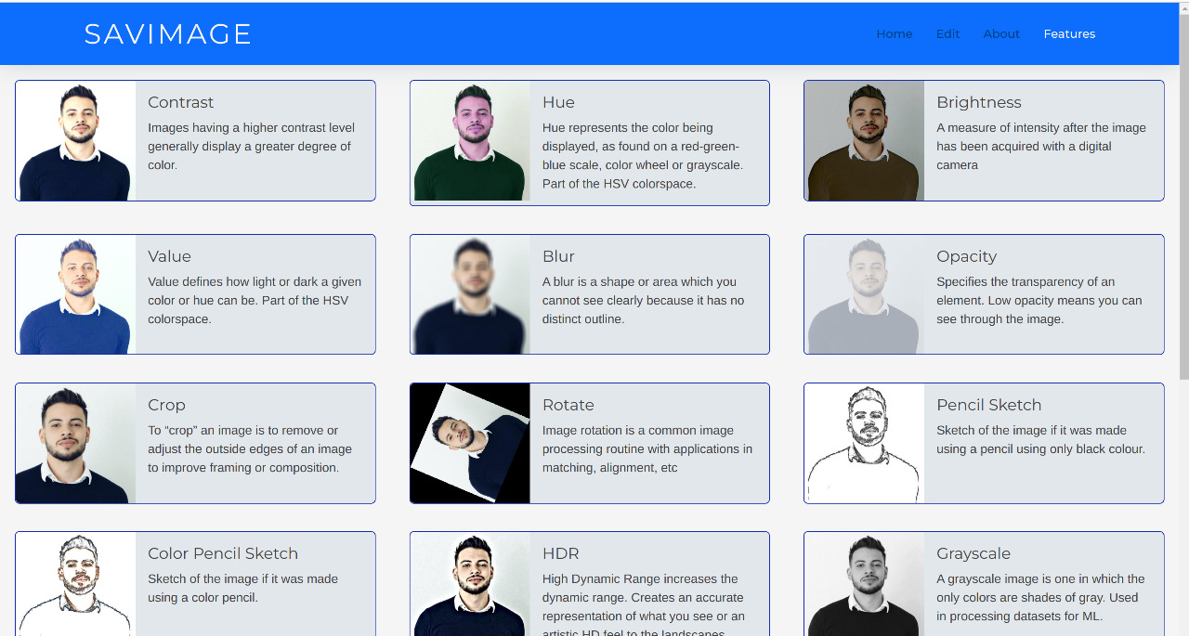
BASIC FILTERS

Slide 6
IMAGE TRANSFORMATION

Slide 7
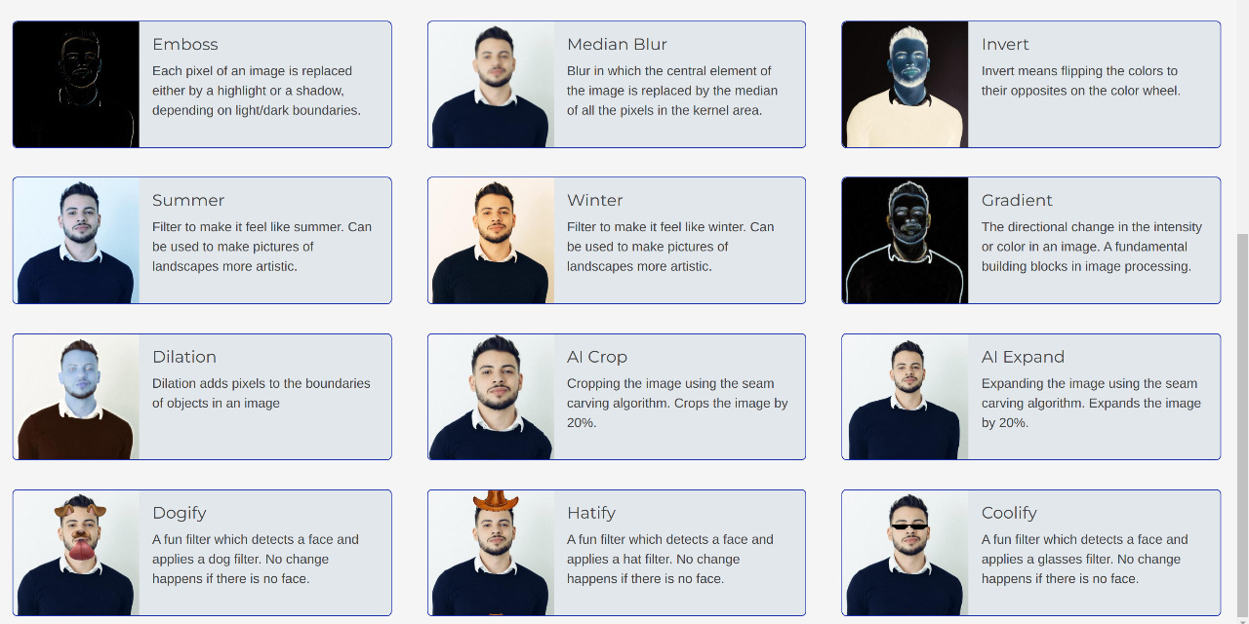
ADVANCED FILTERS

Slide 8
AI FILTERS

Slide 9
AI CROP
Intelligent cropping of an image has been performed using seam carving algorithm.
Seam carving is an algorithm for content aware image resizing.
It functions by establishing a number of seams(paths of least importance) in an image and automatically removes seams to reduce image size or inserts seams to extend it.

Slide 10
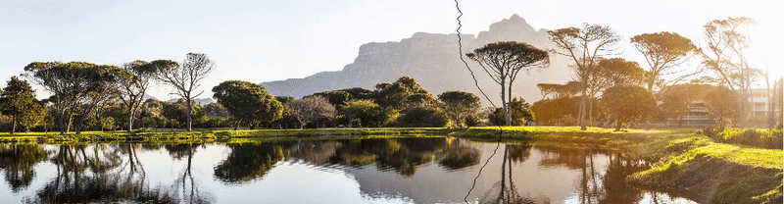
AI CROP

Slide 11
CLASSIFIER BASED AI FILTERS
Classifier are models trained for some object(s), this is a achieved by using set of positive and negative photos.
The classifier can identify the object and provides the coordinates using which we can resize and place the object.
This method can work for both photo and video format.

Slide 12
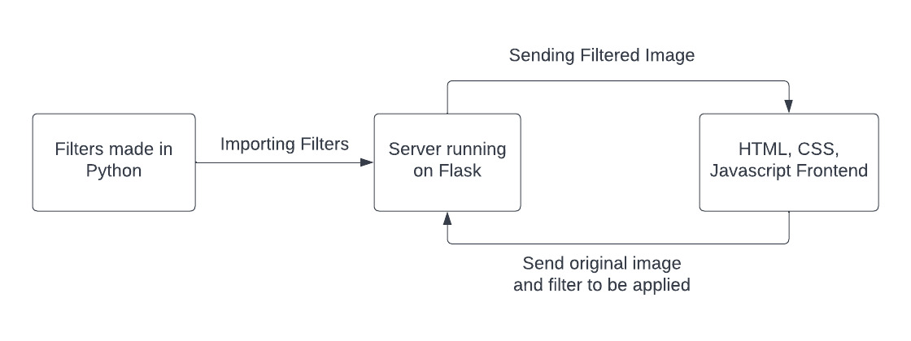
PROJECT ARCHITECTURE

Slide 13
THANK YOU

